Slide 1

WALMART ANALYSIS Mentorness-Task 2 Batch – MIP-DA-13
BY ABHIJEET KUNDU

Slide 2
Project Overview
Objective: The primary goal of this project is to analyze Walmart's sales data to derive actionable insights that can help improve business decision-making processes. The analysis covers various aspects, such as product performance, customer preferences, and sales patterns.
Some detailed analysis are-
Identifying high-performing product lines.
Understanding customer behavior based on demographic factors such as gender and customer type.
Analyzing payment methods to optimize checkout processes.
Determining the best days and times for sales promotions by studying sales trends.

Slide 3
Dataset Overview
The dataset consists of sales transactions from multiple Walmart branches, capturing key details about each sale.
Invoice_ID: Unique identifier for each sales transaction.
Branch: Branch where the sale took place (e.g., A, B, C).
City: City where the branch is located.
Customer_type: Type of customer (Member or Normal).
Gender: Gender of the customer (Male/Female).
Product_line: Category of the product sold (e.g., Health and Beauty, Electronics).
Unit_price: Price of the product per unit.
Quantity: Quantity of the product sold.
Tax_5%: 5% tax applied to the sale.
Total: Total amount of the sale (Unit Price * Quantity + Tax).
Date: Date of the transaction (in dd-mm-yyyy format).
Time: Time of the transaction.
Payment: Payment method used (Cash, Credit Card, Ewallet).
cogs: Cost of Goods Sold.
gross_margin_percentage: Gross margin as a percentage of the sales.
gross_income: Gross income derived from the sale.
Rating: Customer satisfaction rating for the purchase.

Slide 4
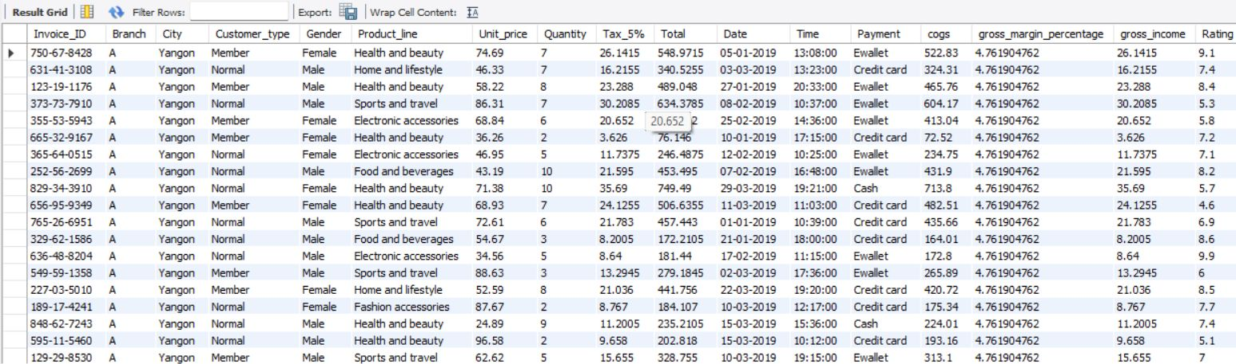
SQL QUERIES
Retrieve all columns for sales made in a specific branch (e.g., Branch 'A').
CODE-
SELECT *
FROM walmartdata
WHERE Branch = 'A';
OUTPUT-

Slide 5
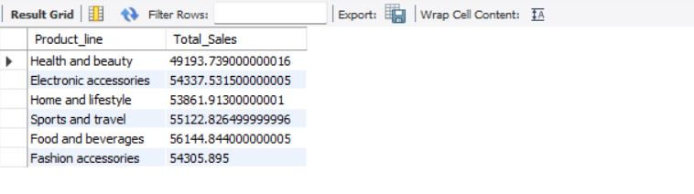
SQL QUERIES
Find the total sales for each product line.
CODE-
SELECT Product_line, SUM(Total) AS Total_Sales
FROM wlmartdata
GROUP BY Product_line;
OUTPUT-

Slide 6
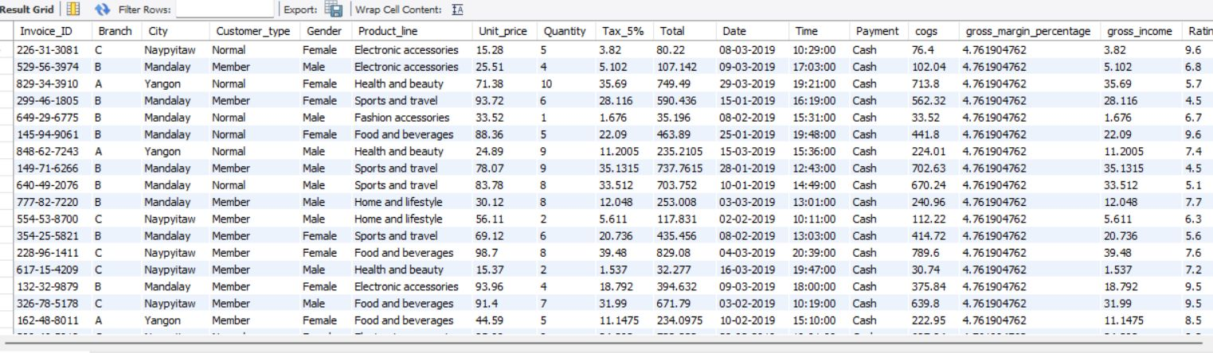
SQL QUERIES
List all sales transactions where the payment method was 'Cash’.
CODE-
SELECT *
FROM walmartdata
WHERE Payment = 'Cash';
OUTPUT-

Slide 7
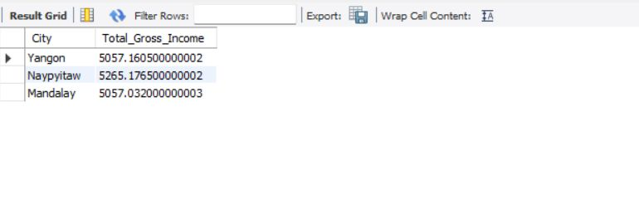
SQL QUERIES
Calculate the total gross income generated in each city.
CODE-
SELECT City, SUM(gross_income) AS Total_Gross_Income
FROM walmartdata
GROUP BY City;
OUTPUT-

Slide 8
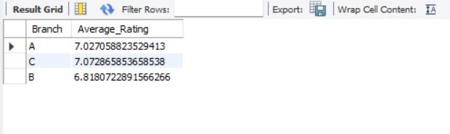
SQL QUERIES
Find the average rating given by customers in each branch.
CODE-
SELECT Branch, AVG(Rating) AS Average_Rating
FROM walmartdata
GROUP BY Branch;
OUTPUT-

Slide 9
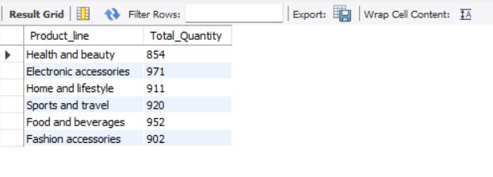
SQL QUERIES
Determine the total quantity of each product line sold.
CODE-
SELECT Product_line, SUM(Quantity) AS Total_Quantity
FROM walmartdata
GROUP BY Product_line;
OUTPUT-

Slide 10
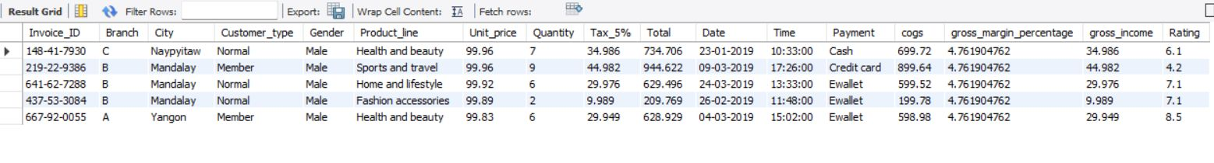
SQL QUERIES
List the top 5 products by unit price.
CODE-
SELECT *
FROM walmartdata
ORDER BY Unit_price DESC
LIMIT 5;
OUTPUT-

Slide 11
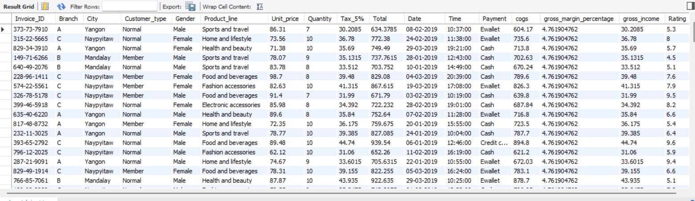
SQL QUERIES
Find sales transactions with a gross income greater than 30. CODE-
SELECT *
FROM walmartdata
WHERE gross_income > 30;
OUTPUT-

Slide 12
SQL QUERIES
Retrieve sales transactions that occurred on weekends.
CODE-
SELECT *
FROM walmartdata
WHERE DAYOFWEEK(Date) IN (5, 6);
OUTPUT-

Slide 13
SQL QUERIES
Calculate the total sales and gross income for each month.
CODE-
SELECT DATE_FORMAT(Date, '%Y-%m') AS Month, SUM(Total) AS Total_Sales, SUM(gross_income) AS Total_Gross_Income
FROM walmartdata
GROUP BY DATE_FORMAT(Date, '%Y-%m’);
OUTPUT-

Slide 14
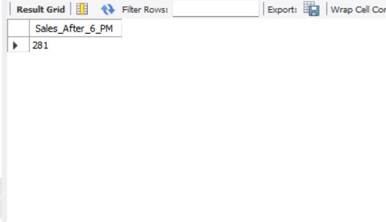
SQL QUERIES
Find the number of sales transactions that occurred after 6 PM.
CODE-
SELECT COUNT(*) AS Sales_After_6_PM
FROM walmartdata
WHERE TIME(Time) > '18:00:00';
OUTPUT-

Slide 15
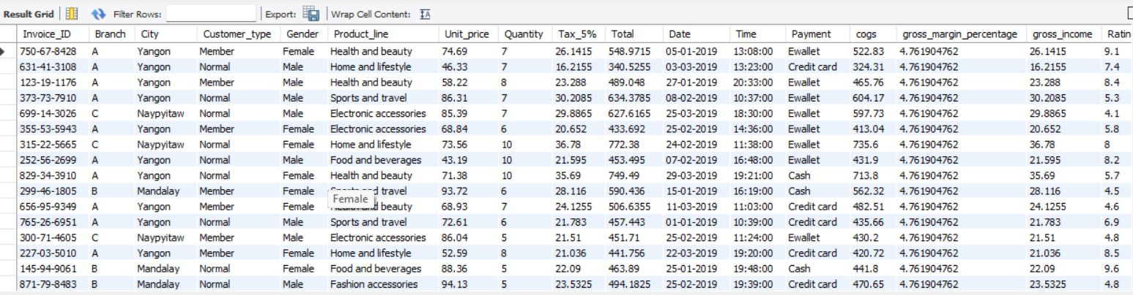
SQL QUERIES
List the sales transactions that have a higher total than the average total of all transactions.
CODE-
SELECT *
FROM walmartdata
WHERE Total > (SELECT AVG(Total) FROM walmartdata);
OUTPUT-

Slide 16
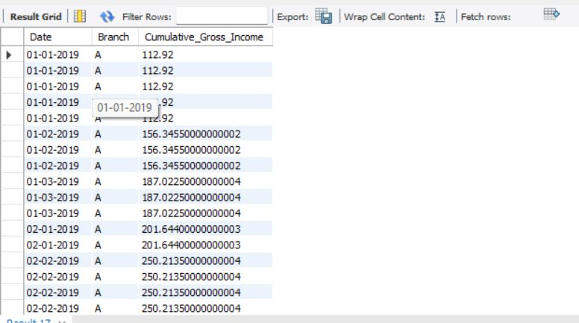
SQL QUERIES
Calculate the cumulative gross income for each branch by date.
CODE-
SELECT Date, Branch, SUM(gross_income) OVER (PARTITION BY Branch ORDER BY Date) AS Cumulative_Gross_Income
FROM walmartdata;
OUTPUT-

Slide 17
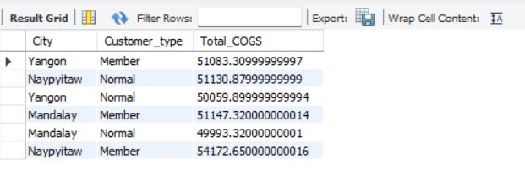
SQL QUERIES
Find the total cogs for each customer type in each city.
CODE-
SELECT City, Customer_type, SUM(cogs) AS Total_COGS
FROM walmartdata
GROUP BY City, Customer_type;
OUTPUT-

Slide 18
CONCLUSION
Summary of Findings:Walmart branches in cities like Yangon have the highest gross income, suggesting higher business potential in these areas.
Health and Beauty and Electronics product lines are top performers, and additional resources and marketing efforts could be dedicated to these categories to maximize revenue.
The preference for Ewallet payments suggests that Walmart should continue to invest in digital payment solutions while still supporting traditional payment methods for customers who prefer cash.
Weekend and evening sales spikes indicate opportunities for targeted marketing campaigns, such as weekend sales and late-evening promotions.

Slide 19
Thank You

